Slide 1
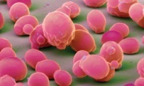

A Gene/Protein Network Model for Cellular Aging
Hong Qin

Slide 2
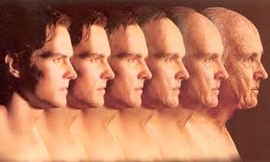
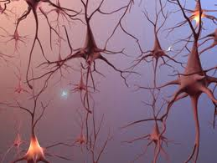
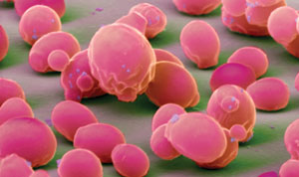
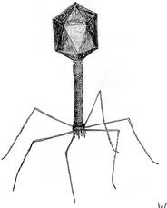
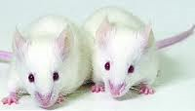
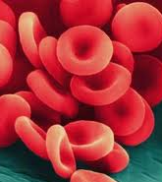
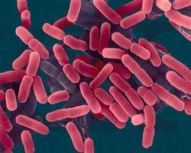

Aging is a fundamental question in biology, yet its mechanism remains elusive.

Slide 3
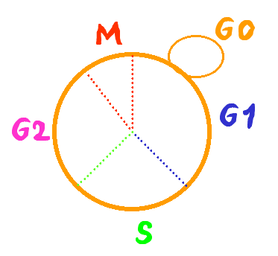
The life span of the budding yeast S. cerevisiae
Replicative life span
  The average number of offsprings of single mother cells
  dividing cells
Chronological life span
  The duration of cells in stationary phase
  non-dividing cells
Notes:
As a cellular organism, the life span of yeast can be measured in two different ways. The RLS and the CLS.
How to assay RLS?
S. cerevisize grow by budding out new cells. The new cells are smaller than the old mother cells. This enable us to identify the mother and daughter cells under microscope and separate them by by micro dissection.

Slide 4
Assay of replicative life span in yeast
new bud
remove bud with micro-manipulator
90 min @ 30 ˚C
repeat until cells no longer reproduce

Slide 5
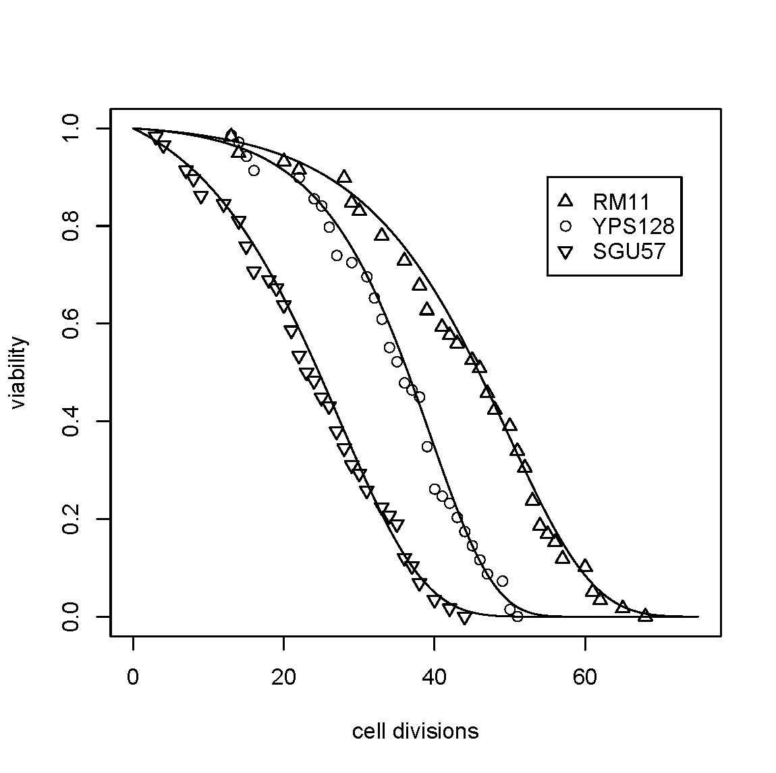
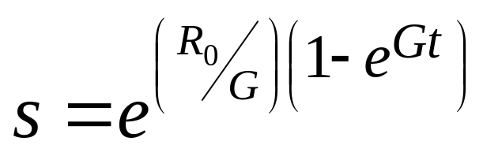
Replicative life spans of yeast isolates
Qin and Lu, 06
Exp Gerontology
Notes:
Regression of avg with group + strain

Slide 6
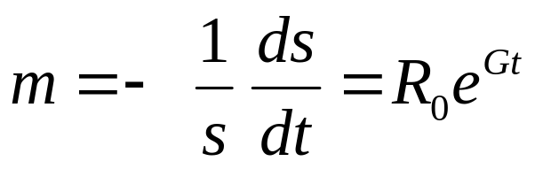
Gompertz model of aging (A descriptive model)
  Aging is modeled as exponential increase of mortality rate over time.
  R₀ : initial mortality rate, innate susceptibility to dying, lifespan potential at birth.
  G: an coefficient for mortality rate acceleration (rate of aging)
Notes:
Gompertz mortality model (constant hazard model)
Mortality Rate: m = - (ds/dt)(1/s) = I₀ e^{Gt}
Viability: s = exp[ (I₀ /G) ( 1 - e^{Gt}) ]

Slide 7
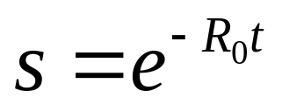
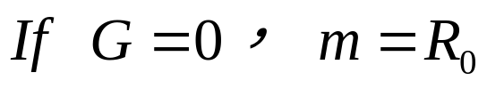
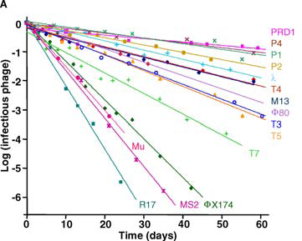
Non-aging systems
De Paepe & Taddei, 2006, Plos Biology

Slide 8
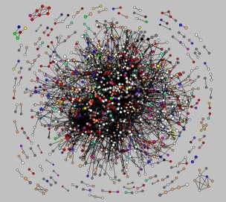
A general theoretic framework for cellular aging
Cellular aging is an emergent property of gene/protein networks

Slide 9
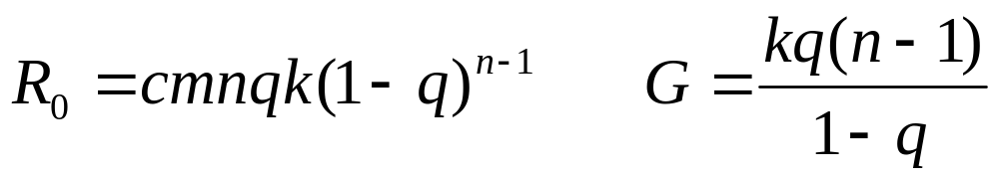
Modular network with stochastic links
Gompertz Aging, i.e. Biological Aging
?
?
?
?
Modular network with
stochastic links
?
?
?
?
?
?
A reliability model
with defects
?
?
?
?
?
?
m: the number of modules
n: the number of links per essential gene (essential module)
k: exponential decay rate (constant aging rate)
q: the chance of a link to be functional ( q = avg func links/ n)
c: a normalization constant

Slide 10
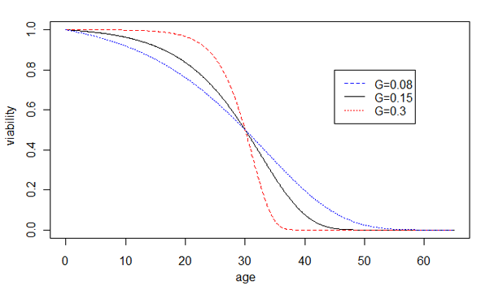
Prediction of the network model of cellular aging
Increased robustness
Decreased robustness
Notes:
Prediction of our hypothesis, the effect of network robustness on the rate of aging G, is shown by changes of the Gompertz survival curves. Increased robustness leads to larger G and faster aging, shown by the sharper transition of the dying off phase, whereas decreased robustness leads to smaller G and slower aging, shown by the slower dying off phase. For illustration purposes, the average life spans are unchanged.

Slide 11
Testing the model:
Diploid cells age faster than haploid cells
Table Aging rate is faster in diploid BY4743 than in haploid strains based on nest model tests.
Models | lnL
H0 I_{BY4741} = I_{BY4742} = I_{BY4743}, G_{BY4741}= G_{BY4742}= G_{BY4743} | -952.7
H1_{g2} I_{BY4741} = I_{BY4742} = I_{BY4743}, G_{BY4741}= G_{BY4742}≠G_{BY4743} | -946.1
H1_{i2} I_{BY4741} = I_{BY4742} ≠I_{BY4743}, G_{BY4741}= G_{BY4742} = G_{BY4743} | -939.4
H2_{ig2} I_{BY4741} = I_{BY4742} ≠ I_{BY4743}, G_{BY4741}= G_{BY4742}≠G_{BY4743} | -937.2
H3_{i3ig2} I_{BY4741}≠ I_{BY4742}≠ I_{BY4743}, G_{BY4741}= G_{BY4742}≠G_{BY4743} | -929.3 | Best parsimonious model p-value=3.6x10⁻¹⁰ (chi-square, df=3) G_{BY4741}= G_{BY4742} = 0.0653 G_{BY4743} = 0.0786
H6 I_{BY4741}≠I_{BY4742}≠I_{BY4743}, G_{BY4741}≠G_{BY4742}≠G_{BY4743} | -929.3

Slide 12
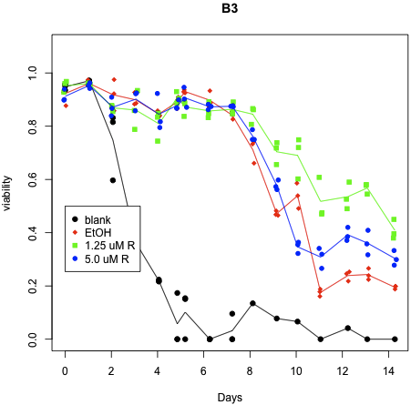
Testing the model:
The effect of radicicol on chronological aging
P-value = 0.027

Slide 13
Implications of the network aging model
Theoretic perspectives
Based on yeast gene/protein networks
Connection between aging and genetic capacitors
Mutation and selection on gene interaction, fitness and aging.
Lethality due to multiple interactions
Power-law networks versus random networks
Heterogeneous rates of exponential decays
Empirical perspectives
G as a proxy of robustness (a phenotypic measure)
Provides a new perspective to interpret experimental data

Slide 14
Summary
A gene/protein network model of cellular aging ― a general theoretic framework. Cellular aging = network emergent property Aging = emergent property of complexity

